Slide 1
Crafting and Imperfection in Design and Beyond
Tobias Busch
Design Thinking and Making KU Leuven, 2018

Slide 2
Crafting human-computer interactions. Frankjaer & Dalsgaard (2018). Proceedings of DIS 2018.
Wabi-Sabi as a design philosophy. Tsaknaki & Fernaeus (2016). Proceedings of CHI’16.
Crafting and Wabi-Sabi in data analysis? Mazur (2016). Big Data & Society.

Slide 3
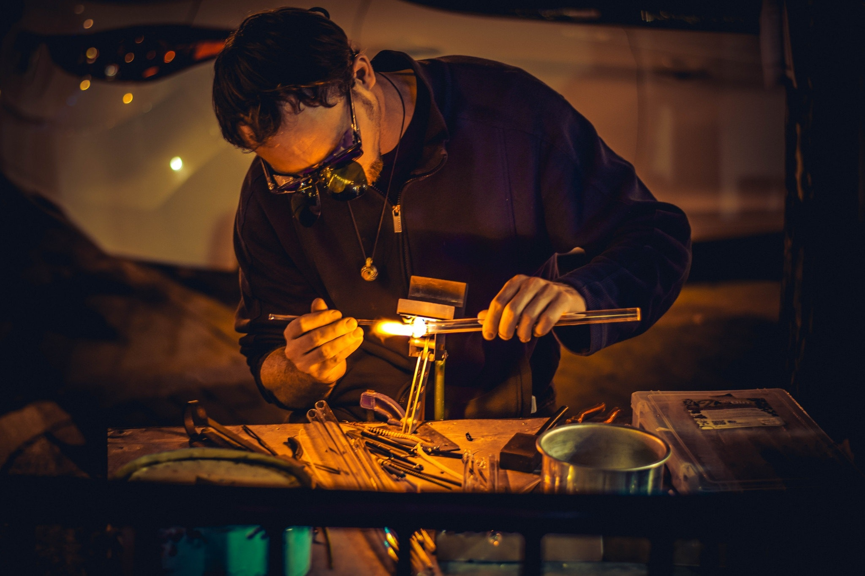
Crafting in HCI

Slide 4
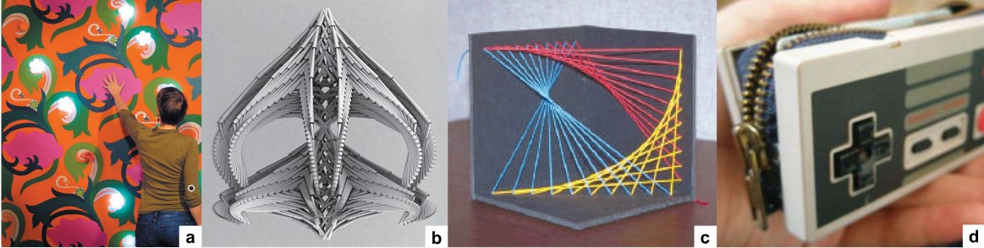
Craft-based approaches in HCI
Hybrid
Integrating electronics with low-tech craft.
Digital
Creating physical artifact using digital tools.
Computational
Using computer-generated patterns as the basis of traditional craft.
Technocraft
Crafting with technological objects.

Slide 5
Characteristics of craft-based enquiry in HCI
Combining analog and digital techniques and processes
Transcending the juxtaposition of computer technology and fabrics.
Small-scale, undivided fabrication process.
Creating highly refined objects
Quality, individuality, attention to detail.
“Handwerker Stolz” – desire to do the job well.
Quality is a result of training.
Creating knowledge through embodied engagment
Somatic engagement, meditativeness, aesthetic awareness.
Reflective conversation with the material and situation, materials interact with the maker’s artistic intelligence and shape ideas.
Tacit knowledge of the material, obtained through practice. Materials and skill are the vocabulary of the crafting process.

Slide 6
The process of crafting, according to R. Sennett
The unplanned is the exciting part.
1. Localization
Identify where something important is happening, find the interesting focal point.
Crafter attunes to the material, uses tacit knowledge beyond language.
Crafter continuously negotiates with the material, as opposed to planning before action.
Embedding the digital in a material allows to interfere with its properties on a structural level.
2. Questioning
Question the digital and physical components.
Crafter suspends a resolution in order to probe.
Actions are constantly recalibrated based on the “answers” the material gives.
3. Opening
Establish new and surprising connections.
Dare to make intuitive leaps.
Draw on hunches, serendipity remote associations, and combine disparate part.
Enabled by diffuse—rather than focused—attention and awareness of the periphery.

Slide 7
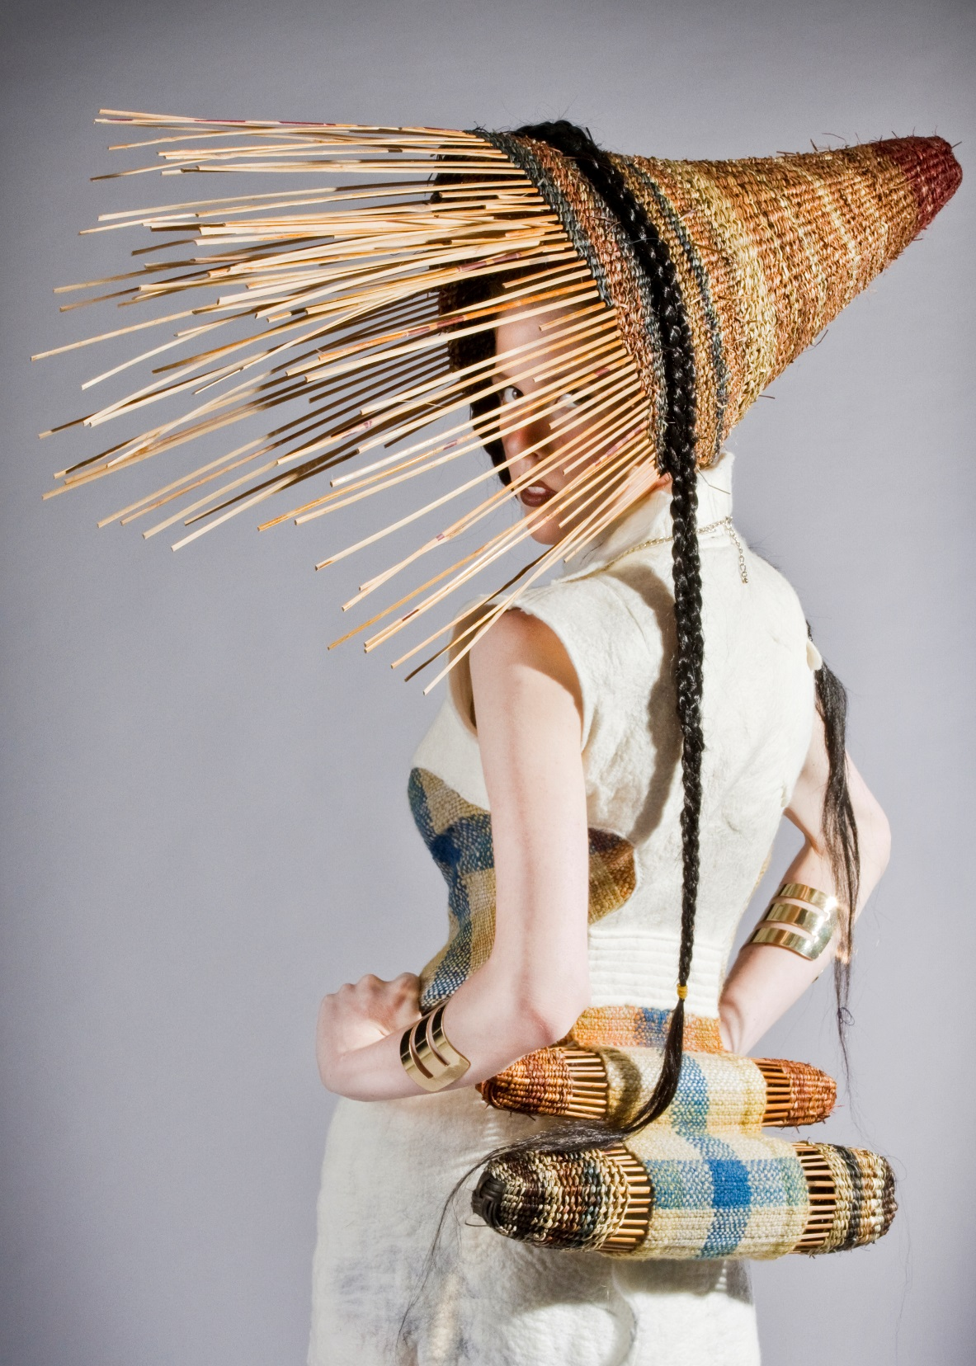
Example: Bamboo Whisper
Exploring wearable technology based on organic material.
“The project found its shape through an unfolding process of exploration of possible percussive expressions, achieved by running a vibrating motor attached to the emerging artifact during the crafting process.”
Localization: Trying different algorithms and weave structures.
Questioning: The most interesting effect resulted from an unintended glitch in the code that made the author question the desired qualities.
Opening: The glitch became the shape around which the material was shaped.

Slide 8

Wabi Sabi – nothing lasts, nothing is finished, nothing is perfect

Slide 9
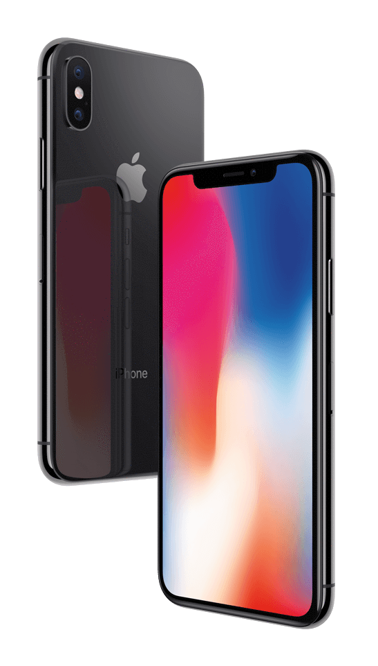
The 2 Faces of Technology
Lasting, finished, perfect.
Mass-produced, robust.
Promise of limitlessness and permanence, e.g. “the cloud”.
Breaking, difficult to repair, planned obsolescence. e.g. disk space full, battery life short, buttons fall apart, files corrupted.
Going out of fashion, constant development, shaped by changes in socio-technological context. e.g. file formats and hardware no longer supported, interaction concepts being replaced.
Soft- and hardware connected in a cycle of mutual obsolescense.
→ Wabi-Sabi, rather than trying to overcome imperfection and impermanence, acknowledges them as a reality, thereby speaking to our desire for authenticity and honesty.
Notes:
Honesty about the material properties and limitation of electronics.

Slide 10
Wabi Sabi – nothing lasts, nothing is finished, nothing is perfect
Wabi. The essence of simplification, cutting things down to the important.
Sabi. The passage of time, the fact that the core of something remains the same, even though the facade or surface may change over time.
These realities are embraced and engaged with. Attention is directed towards traditional crafting and resourceful use of authentic and organic materials.

Slide 11
3 themes of Wabi-Sabi in HCI
Nothing Lasts - Design for long-term interaction through conscious use of impermanent materials and media.
Impermanence of material is a design opportunity rather than an obstacle.
Explicit use of fragile material and material traces, accepting the need for “caretaking” over time.
Opportunity for constant development.
Conjure a sense of liveness – objects will age with time.
Impermanence engages users in a different way (e.g. Snapchat, ephemeral user interfaces).
Nothing is Finished - Approach perfection through explicitly unfinished designs.
All material entities undergo constant changes – be it slow or fast, subtle, or drastic.
The tension between desire for completion and constant flux, can be a resource.
Enable long lasting and constant progress through use of materials with potential for adaptation. repair, upgrade, extension, tweaking. Materials like leather, wood, paper also offer new types of interactive qualitites.
Incompleteness helps users solve their own problems.
Nothing is Perfect - Engage with the richness of interactive expressions by embracing limitations in current technology.
Perfection is a moving target, changing with practice, fashion, technical development, intentions and skills of the designer.
Questioning the ideals of “perfection as uniformity”. Unique and imperfect outcomes of small-scale fabrication tools. Imperfection inherent in organic materials, handcrafted objects is unique, graceful.
Interaction design as crafting – “thinking through making things by hand”, design decisions taken on the spot. A dialog with the materials and available resources.
Embrace what is available. As opposed to chasing vision of the future.
Notes:
Decisions taken on the spot rather than planned once and then mass-produced (but not advocating for sloppiness)
Computer programming and making software as crafting practice (see next part)
Timeless perfection does not exist.

Slide 12


Slide 13
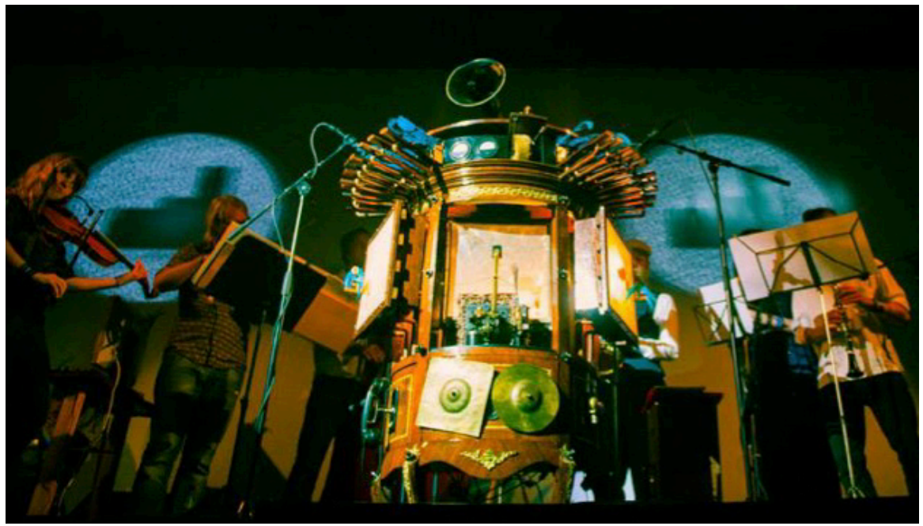
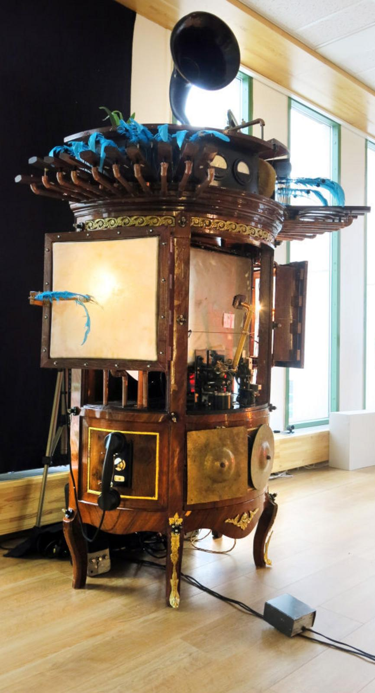
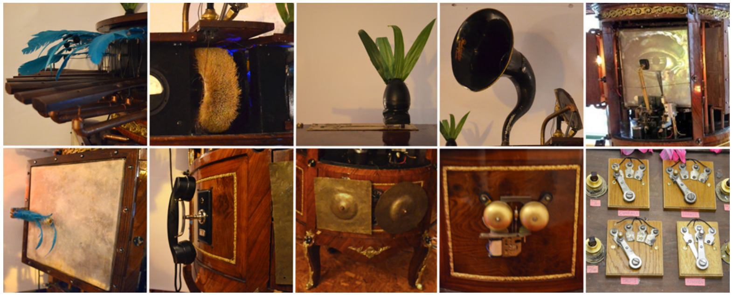
Example Ajna, the Musical Cabinet
“an obscure, musical bricolage, made from a heterogeneous collection of parts including electromechanical devices, old musical instruments, microcontrollers, wood, feathers, skin, motors, potentiometers–all hosted within the frame of a vintage rococo cabinet.”
Made from fragile organic matter and objects with a unique history for functional and aesthetic reasons.
Permanently “under construction” and being adapted to different situations.
Makes it seem organic, alive.

Slide 14
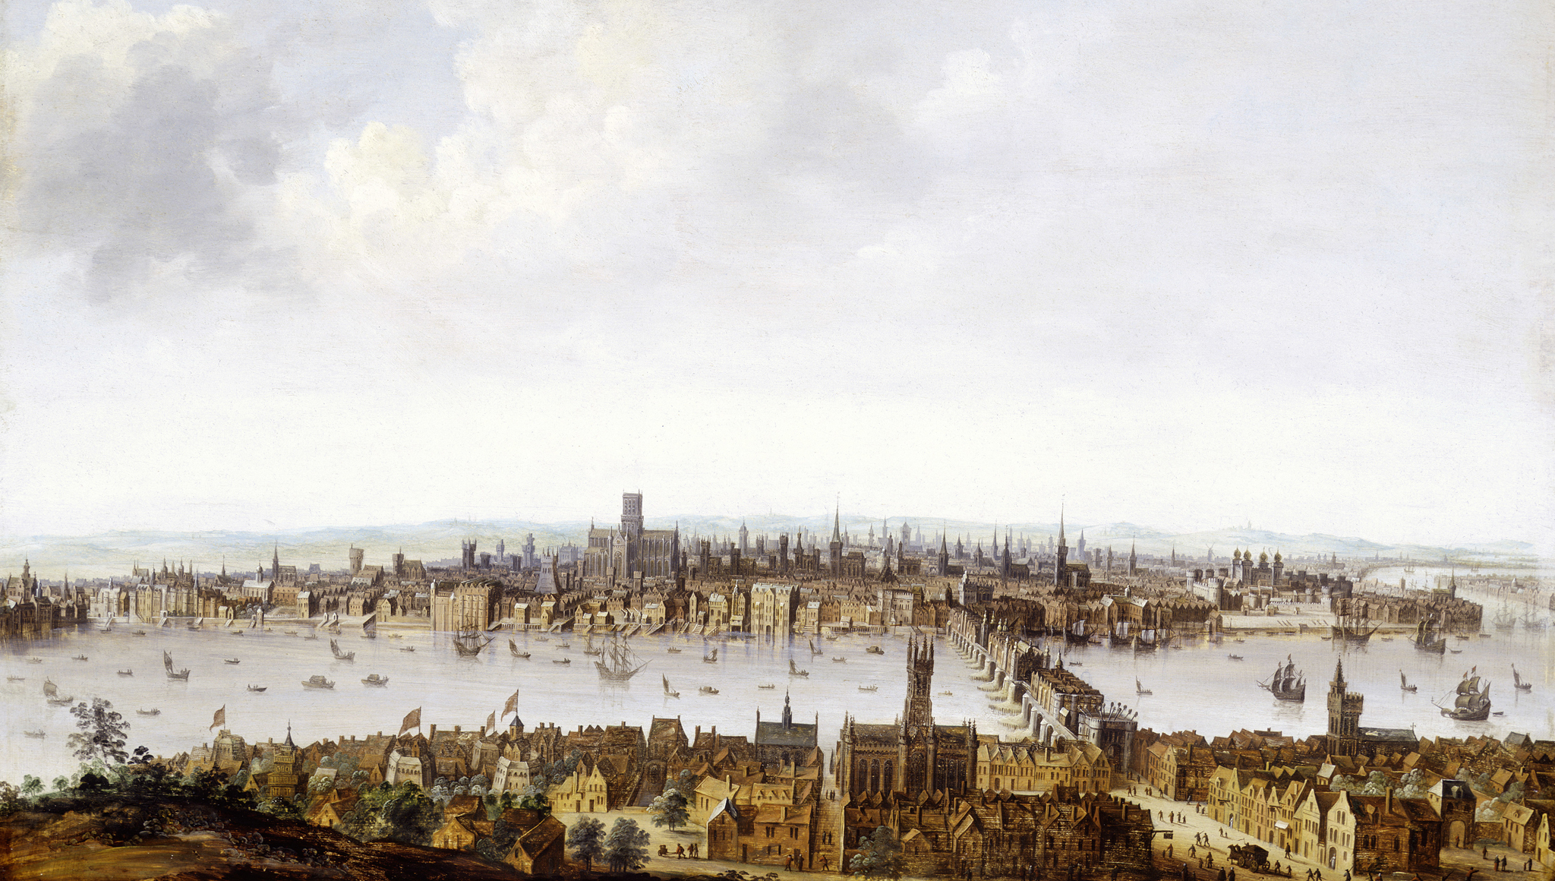
Analyzing Imperfect Big Data in the 1600s
John Graunt’s (1620-1674) “Natural and Political Observations Made Upon the Bills of Mortality”.
Hypothesis 1: Data Analysis is a Craft, in which data is the material used to create knowledge.
Hypothesis 2: Every data analysis is impermanent, unfinished, and imperfect. Wabi-Sabi principles can be applied to deal with this.

Slide 15
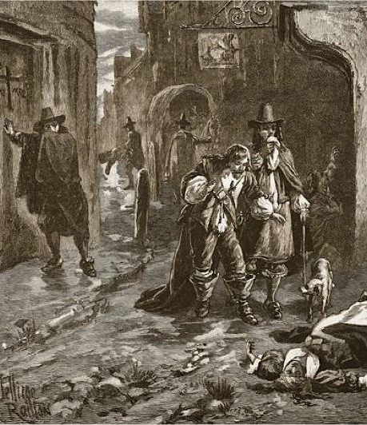
How to die in 17th century London
The deceased kicks the bucket.*
A church bell is rang. (“never send to know for whom the bell tolls; it tolls for thee”)
A Searcher of the Dead, and sometimes a doctor, assesses the cause of death.
The parish clerk announces the death in the weekly “Bill of Mortality”.
“The Bills” were first published in 1592. The number of death by causes and sex was first included in 1629.
* Popular methods include: plague and fever, consumption, convulsions, distracted, drowned, executed, found dead in the street, frighted, griping in the guts, hang’d and made away themselves, kill’d by several accidents, murdered and shot, overlaid and starved, plague, planet, rising of the lights, smallpox, spleen, spotted fever, stopping of the stomach, surfeit.

Slide 16
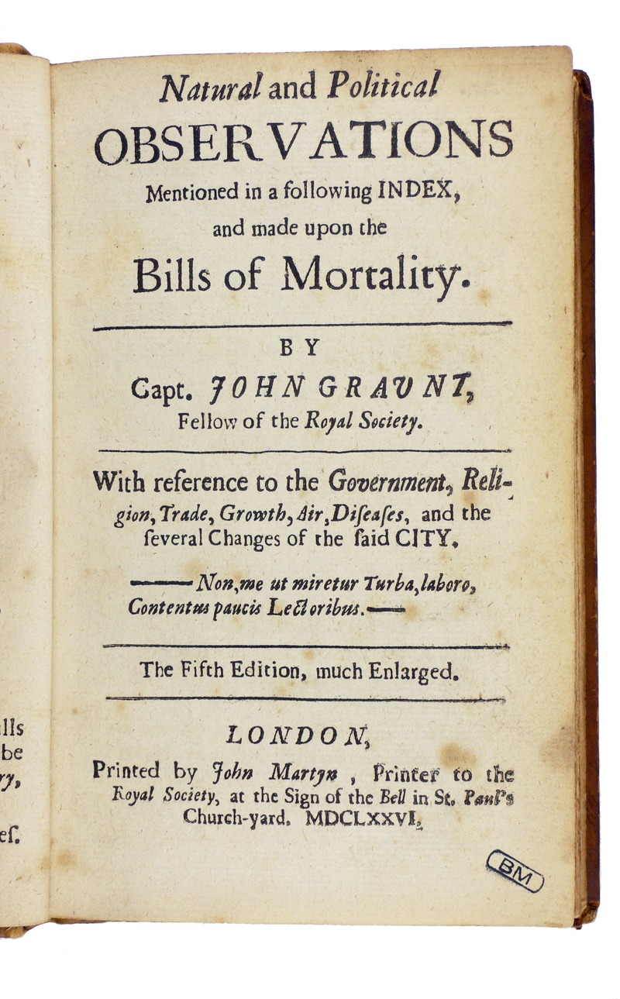
Graunt’s “Observations”
The Bills were imperfect, and neglected until they passed under the scrutiny of John Graunt.
- a tabulation of diseases in London, and a life table.
Graunt’s goals:
Extracting information from “The Bills” for the use in society. Helping the state understand itself and its resources.
Learning how to make improvements of the existing data set.
Specifying imperfections in order to improve the design of future data collection methods.
Notes:
“I do not work so that I will be admired by the crowd, but am content with a few readers”

Slide 17
Imperfections in “The Bills”
Failure to recognize and include variables.
Age at time of death was only included in 1782.
Errors in data description.
Wrong cause of death entered by the Searchers, who were not trained well.
Unclear which criteria were used (e.g. what is an “Infant”).
Plague initially often classified as “spotted fever”, perhaps even willfully to conceal the outbreak.
Inclusion of inappropriate date.
Strong unquantified growth and fluctuation of London’s population during the period of data collection.

Slide 18
How did Graunt deal with the imperfections?
Informing the readers how points of error were treated.
Pragmatism:
whether a child was abortive or stillborn or whether the aged person without any curious determinant could be categorized as dying ‘‘purely of age’’ were decisions that the Searchers could make on their own.
‘‘If one died suddenly, the matter is not great, whether it be reported in The Bills, Suddenly, Apoplexie, or Planet-stricken.”
“it matters not to many of our purposes, whether the disease was exactly the same as physicians define it in their books.’’
Fictitious life tables, based on assumptions about age distribution.

Slide 19
Imperfect, but impactful.
First statistics-based estimation of London’s population.
Influential in England, France, and Holland for the implementation of pension plans.
Led to the adoption of “parish houses” in France by Louis XIV. Laplace later (in 1786) used the parish house data to calculate the population of France.
Used as a warning system for the bubonic plague.
Charles II made Graunt a member of the Royal Society.
Methods provided a framework for modern demography.
Notes:
: inhabitants of London used the tabulated data to make decisions on when to leave London, and when to return, to escape the plague.

Slide 20
Discussion: Is Data Analysis a Craft?
Characteristics of Craft-based enquiry
Combining analog and digital techniques and processes, little division of labor.
Creating highly refined objects, “Handwerkerstolz” .
Creating knowledge through embodied engagement. Meditative, reflective conversation with the material.
The process of crafting, according to R. Sennett
Localization - Identify where something important is happening, using tacit knowledge of the material.
Questioning - Suspend resolution to probe, constantly question the material and recalibrate actions. Thinking through making.
Opening - Establish new, surprising connections. Draw on hunches, serendipity.

Slide 21
Discussion: Wabi-Sabi in Data Analysis?
Nothing Lasts - Design for long-term interaction. Conjure a sense of liveness. Accept the need of caretaking over time as an opportunity for constant improvement.
Nothing is Finished - Approach perfection through explicitly unfinished designs. Enable long lasting and constant progress.
Nothing is Perfect – Embrace limitations. Work with what is available, rather than chasing visions. Perfection is a moving target, depending on skills, technology and context.

Slide 22
